Slide 1




Where to Work tool
Jeffrey Hanson, Richard Schuster, Jaimie Vincent, Joseph Bennett
Demo at https://ncc.carleton.ca

Slide 2
Background
Project initiated by NCC/Carleton in 2020 (approx. $1.2 million NCC, $300K Carleton)
NSERC Alliance Grant for supporting research in 2021 ($960K)
ECCC is partner on Alliance
New ECCC GnC in 2021 ($386K) for additional research on priority-setting
Notes:
NCC approached us in 2019; project started 2020 – tools to modernize their prioritization approach
Alliance for supporting research – crucial, because tools sophisticated, but require some research to carefully set parameters – they are still subject to uncertainty in data, research to help resolve and better handle some of that
Note that ECCC is partner on the supporting research. ECCC also provided us with a grant that is partly related – part of our mandate for the grant is to do additional research to help priority-setting.

Slide 3
Systematic conservation planning
Provides evidence-based, repeatable, and structured approach for designing new protected areas that efficiently meet conservation objectives

Slide 4
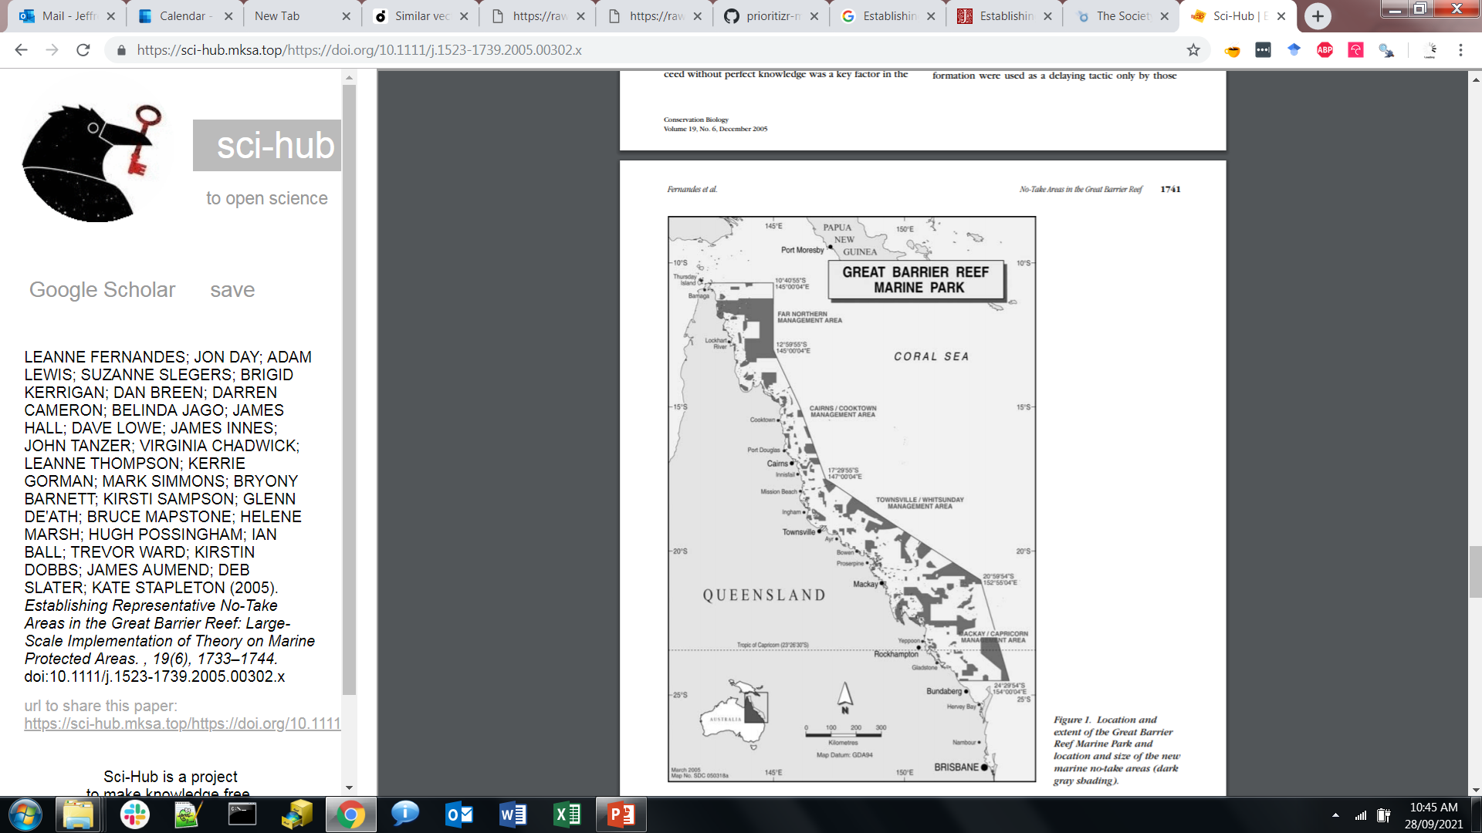
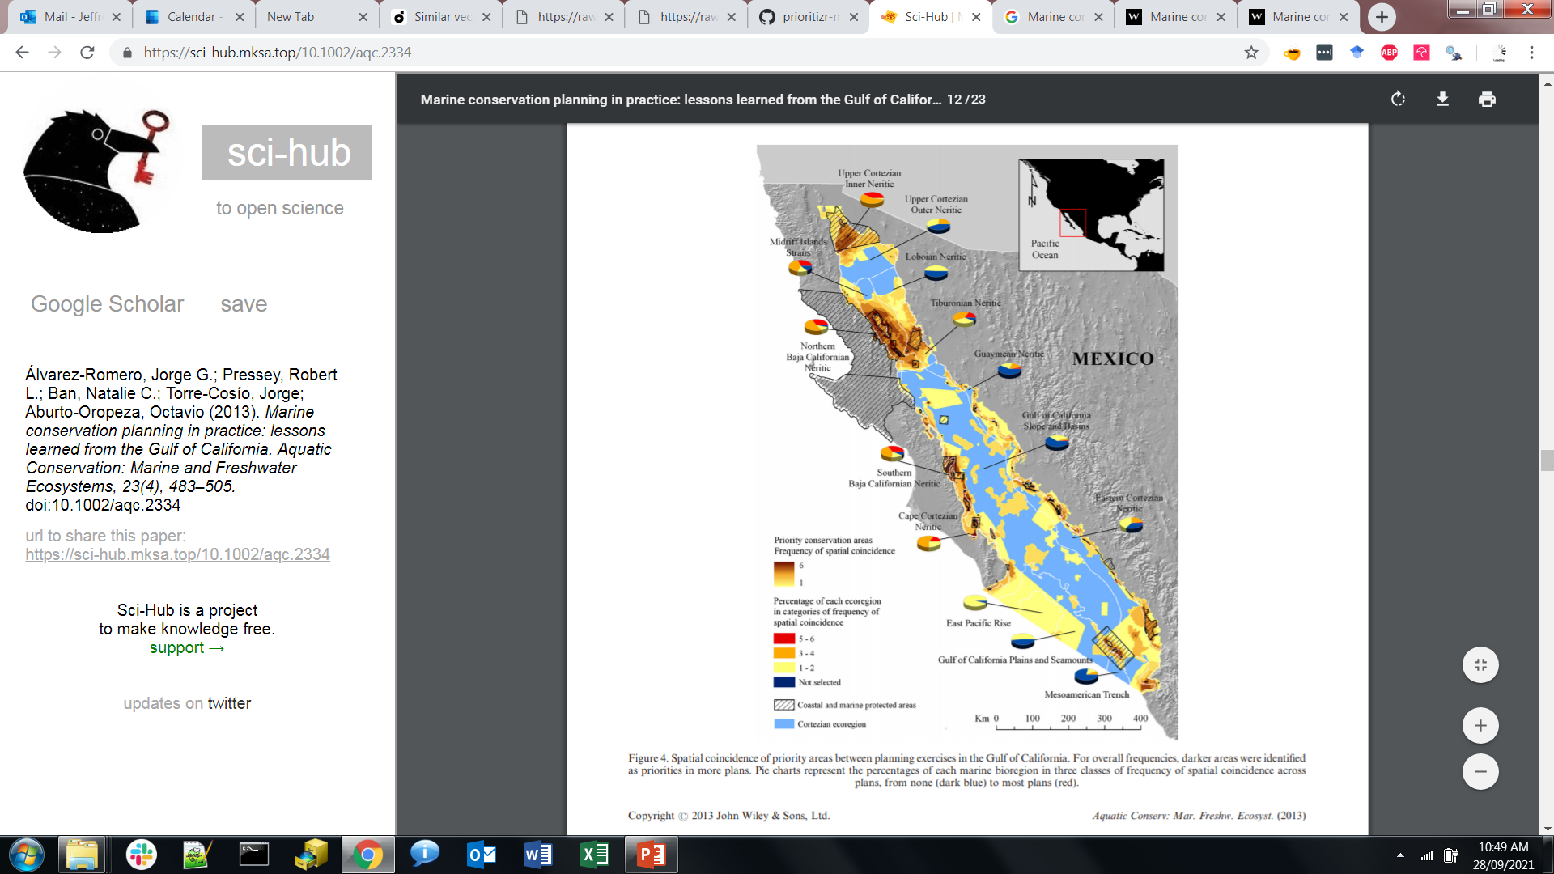
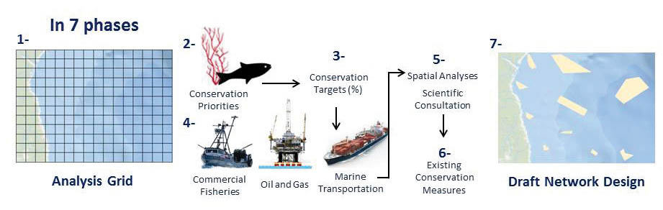
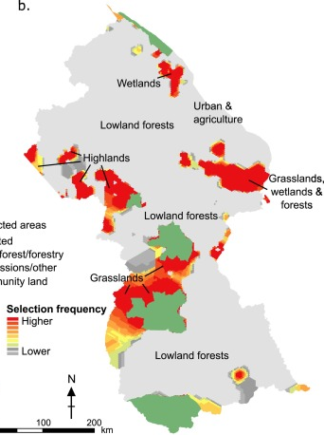



Real-world examples
Great Barrier Reef
Australia
Gulf of California
Mexico
Fisheries and Oceans Canada
National system
Guyana
Decision support tools:

Slide 5
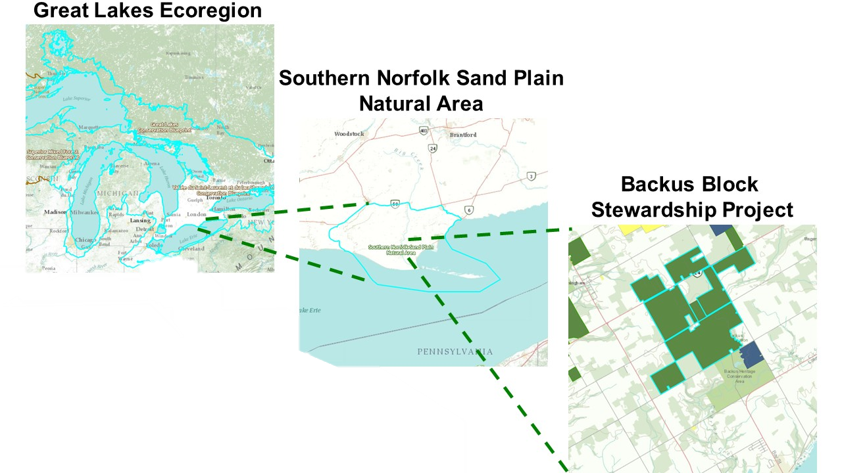
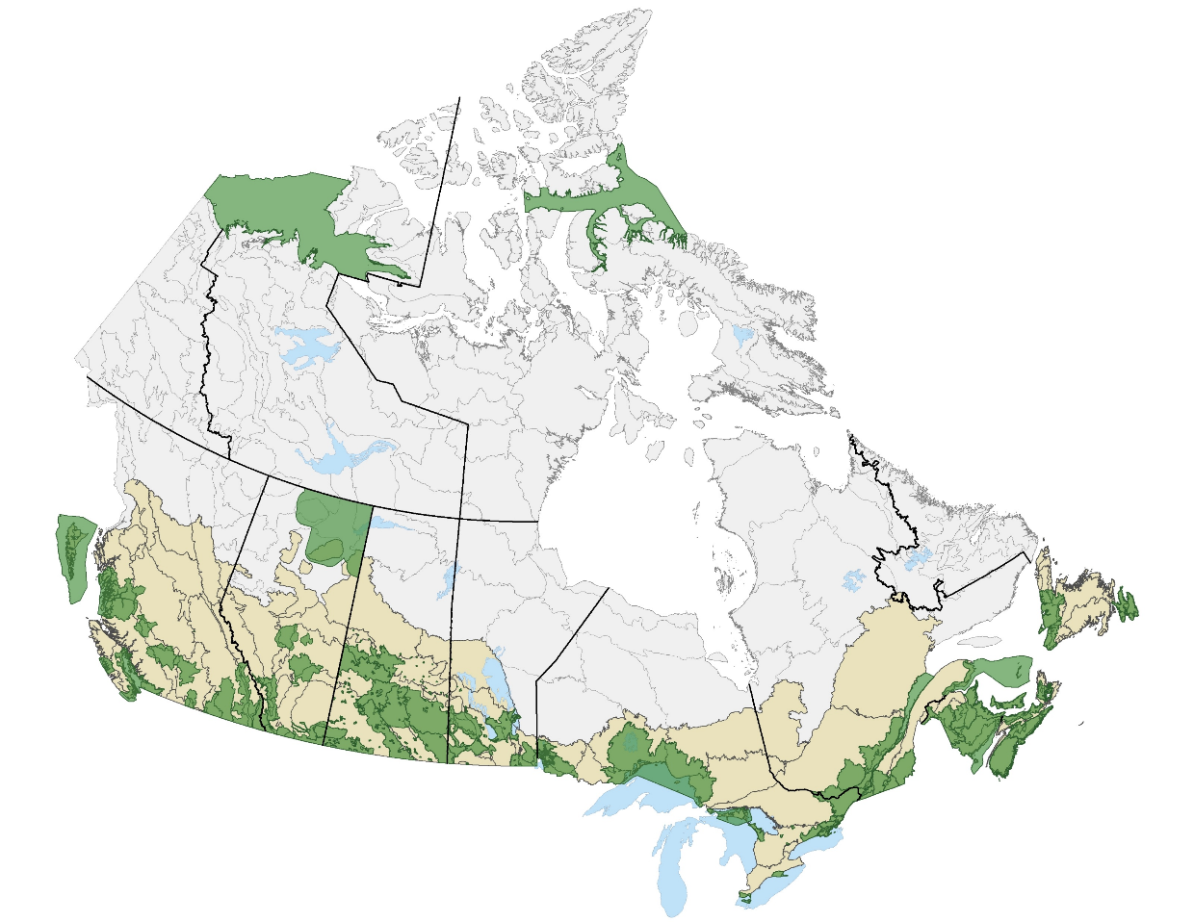
NCC’s current planning approach
NCC’s current approach:
Hierarchical approach
Varies across regions
No prioritization beyond land securement
Gaps and Challenges:
No roll-up
Little inclusion of threats
Time consuming and simplistic

Slide 6
Modernizing NCC's conservation prioritization methods
Standardizing conservation planning framework across the country
New tools and methods will be a game changer in the way NCC prioritizes where to work and what to do
User friendly web tools, based on sophisticated scientific approaches
Framed within Conservation Standards approach

Slide 7
Strengths of our tools
Easy-to-use graphical user interface
FAST! Near real time analysis for stakeholder meetings and discussions
Algorithm guarantees mathematically optimal results – consistent across Canada

Slide 8
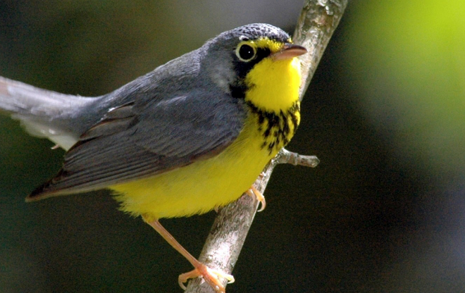
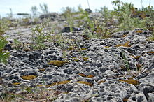
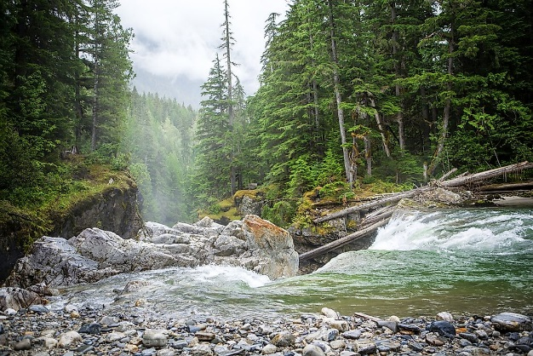
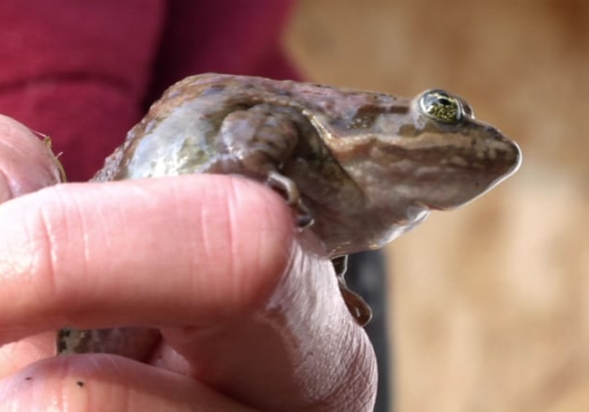
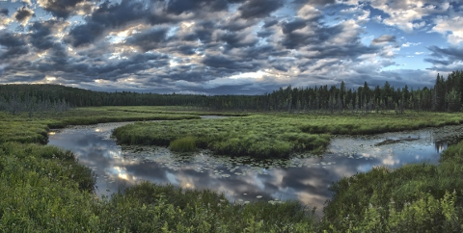
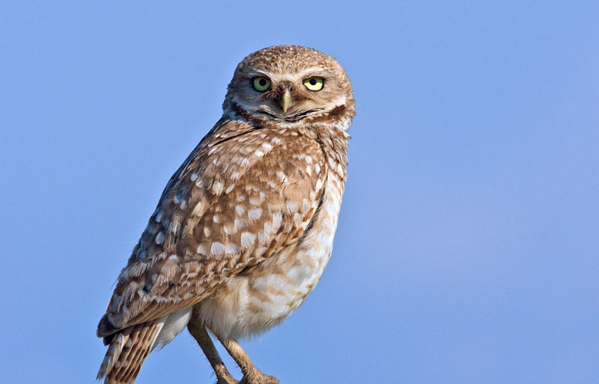
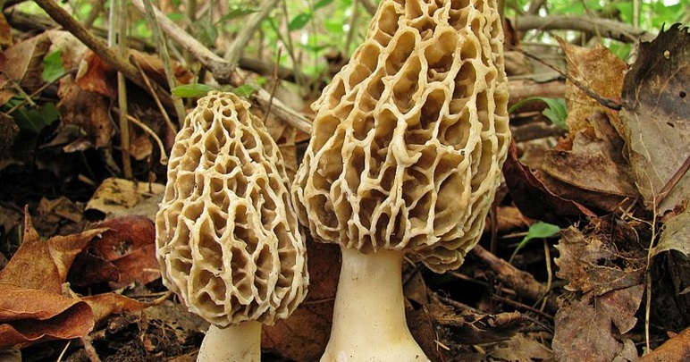
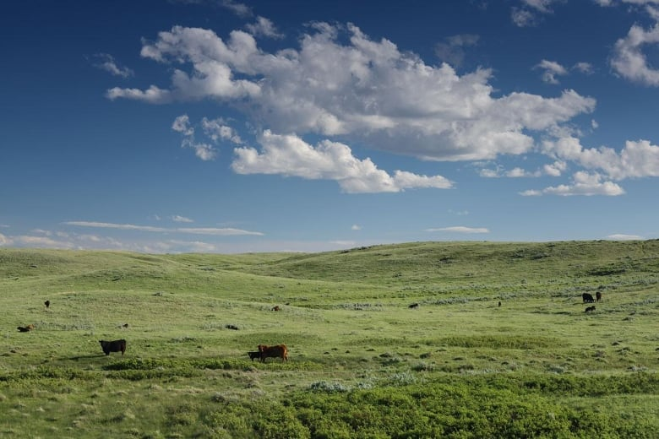
Framing a conservation planning problem
Themes: facets of biodiversity that are important for conservation
Goals: set to ensure a minimum percent coverage in solutions

Slide 9
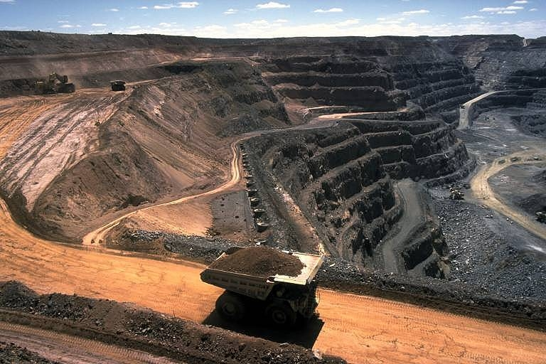
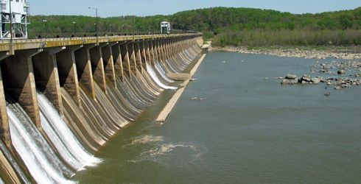
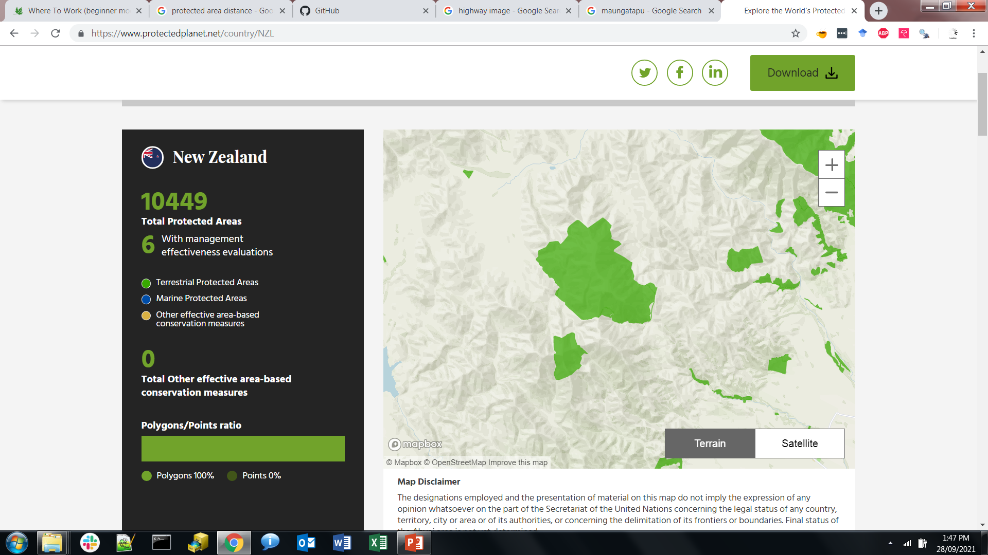
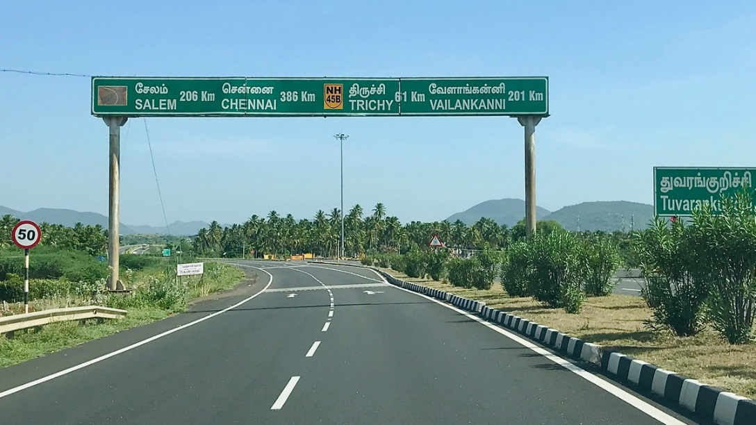
Framing a conservation planning problem
Weights: properties of places that impede or improve conservation efforts
(e.g. carbon sequestration, climate risk)
Factors: indicate importance for avoiding or covering
Factor 0 → 100:
important to cover
Factor 0 → -100:
important to avoid

Slide 10
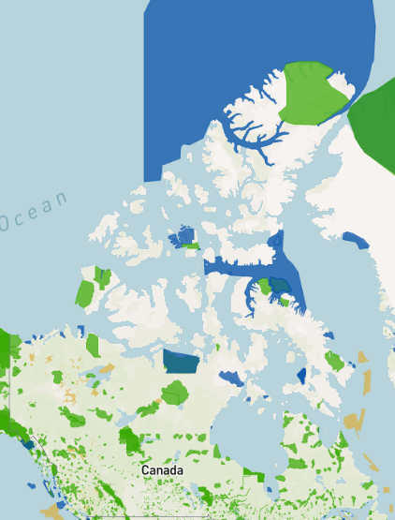
Framing a conservation planning problem
Includes: places that are already managed for conservation
By selecting Includes, solutions can build on existing conservation efforts

Slide 11




Conservation planning as optimization
Themes: Different species
Goals: ≥ 1 population per species
Weights: None
minimize # islands
Includes: None
What’s the solution?

Slide 12
Conservation planning as optimization
Themes: Different species
Goals: ≥ 1 population per species
Weights: None
minimize # islands
Includes: None
What’s the solution?

Slide 13
Conservation planning as optimization
Themes: Different species
Goals: ≥ 1 population per species
Weights: None
minimize # islands
Includes: Existing reserves
What’s the solution?

Slide 14
Conservation planning as optimization
Themes: Different species
Goals: ≥ 1 population per species
Weights: None
minimize # islands
Includes: Existing reserves
What’s the solution?

Slide 15

Conservation planning as optimization
Themes: Different species
Goals: ≥ 1 population per species
Weights: Mining scores
Minimize sum of scores
Incudes: Existing reserves
What’s the solution?

Slide 16
Conservation planning as optimization
Themes: Different species
Goals: ≥ 1 population per species
Weights: Mining scores
Minimize sum of scores
Incudes: Existing reserves
What’s the solution?

Slide 17
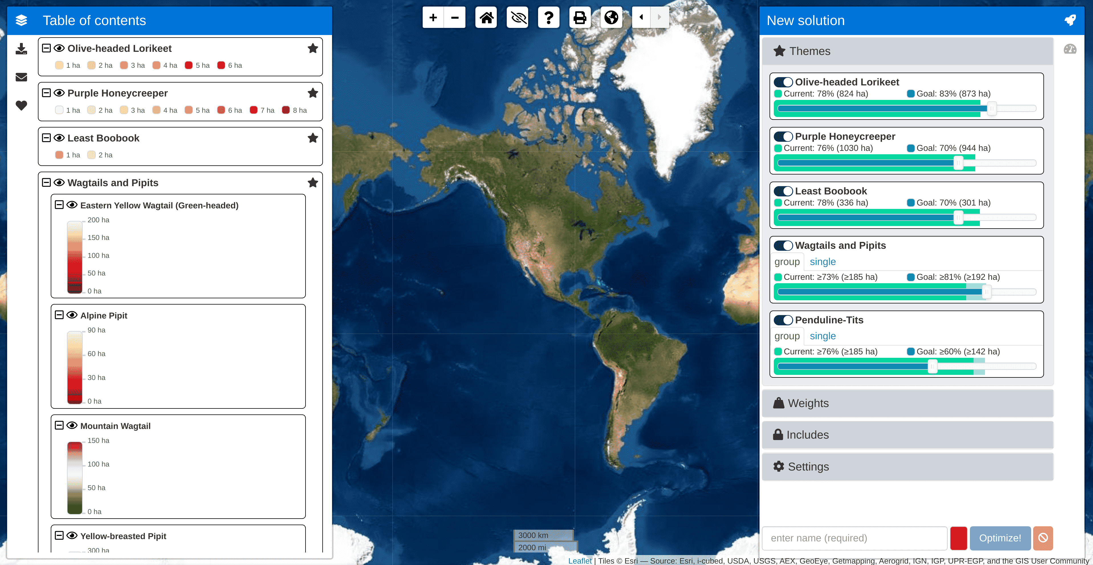
Where to Work tool
Interactive design
Multiple modes
Fast and accurate
Explore uncertainty
Solutions in near real-time

Slide 18
Demo with Ontario pilot
https://ncc.carleton.ca/

Slide 19


Thanks for listening!
Jeffrey Hanson (jeffrey.hanson@uqconnect.edu.au)
Richard Schuster (richard.schuster@natureconservancy.ca)
Jaimie Vincent (jaimievincent@cmail.carleton.ca)
Joseph Bennett (josephbennett@cunet.carleton.ca)
Demo at https://ncc.carleton.ca

Slide 20
Where to Work tool tool
What to Do tool
Priority
Restoration
Eradicate
pests
Weeding

